Slide 1
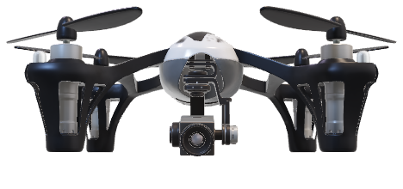
Milestone I Presentation
FPGA for Machine Learning on a Drone

Slide 2
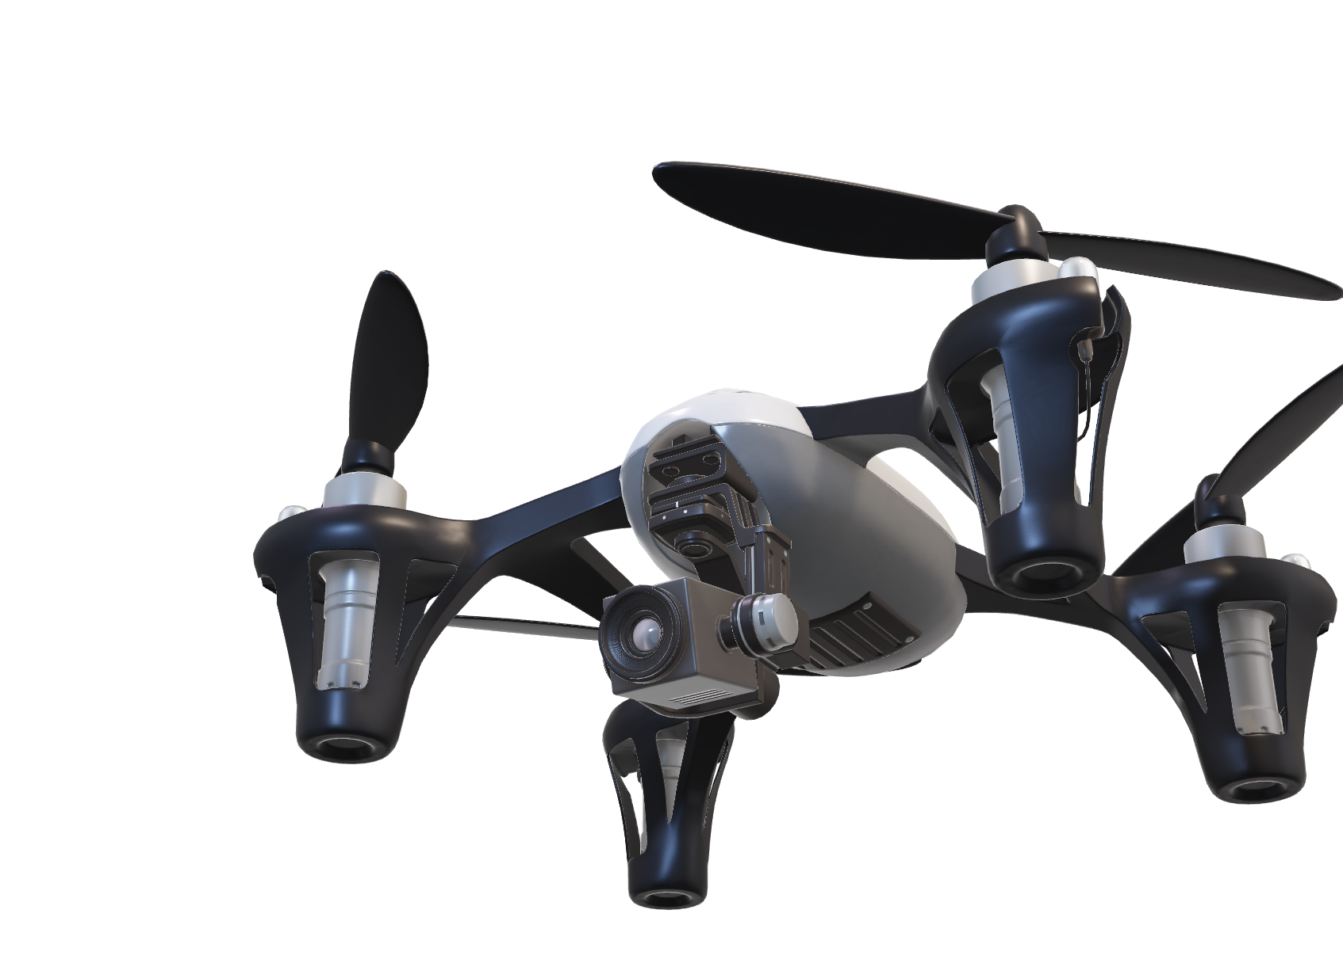
Presentation Overview
Context and Purpose
Requirements
Constraints
Viability of the Project
Risks
Risk Mitigation
Solution Path

Slide 3
Why
?

Slide 4



Context & Purpose
Increasing machine learning and drone applications
No existing combination of FPGA + ML + drone on the market
FPGA

Slide 5

Context & Purpose
Want to combine all of them → computing platform
Accelerate ML using FPGA
FPGA on deployed on the drone
For client’s ML research
Communicate with ground station
Detect pedestrians from above
FPGA

Slide 6

detecton_00 confidence: 0.95 err: 0.08
detecton_04 confidence: 0.95 err: 0.16
detecton_07 confidence: 0.92 err: 0.11
detecton_03 confidence: 0.88 err: 0.06
detecton_06 confidence: 0. 1 err: 0.09
detecton_02 confidence: 0.99 err: 0.11
detecton_01 confidence: 0.99 err: 0.06
detecton_17 confidence: 0.57 err: 0.21
detecton_16 confidence: 0.65 err: 0.23

Slide 7
Requirements
&
Constraints

Slide 8
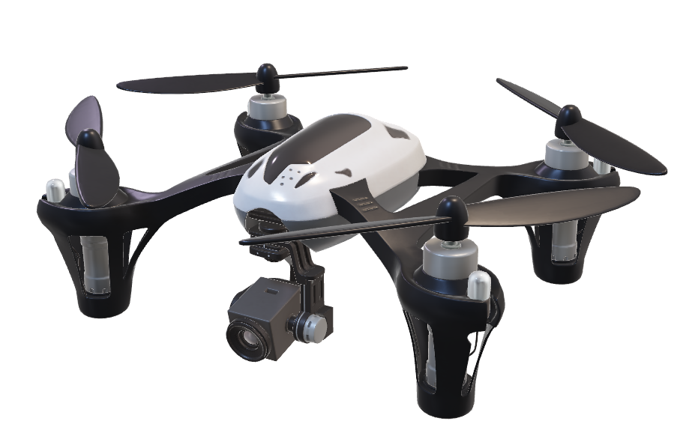
Requirements
Integrated Drone Requirements
Capable of flying with the computing platform
Flight duration at least 10 minutes
Remote controlled by the pilot

Slide 9
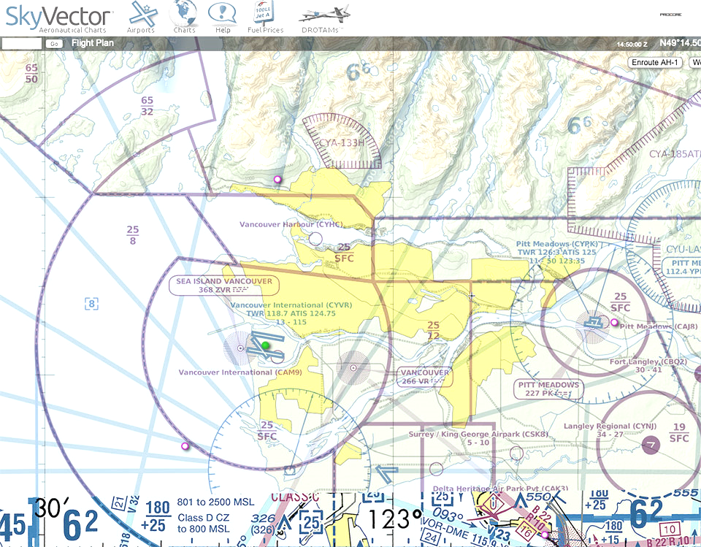
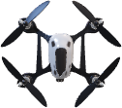
Requirements
Drone Legal Requirements
Operation is compliant with Transport Canada
Tests inside YVR controlled airspace is permitted

Slide 10

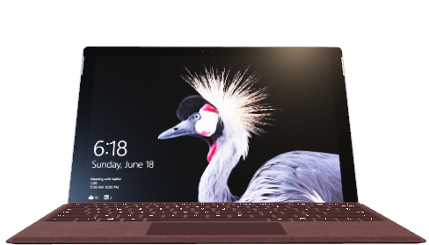
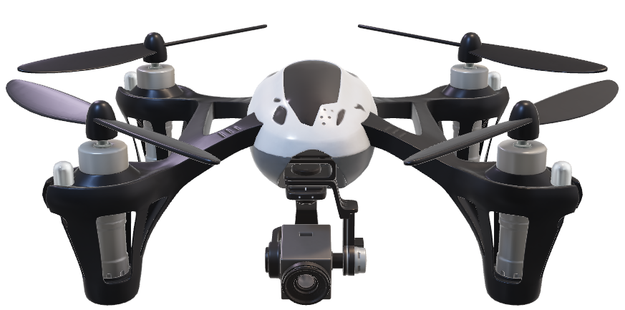
Requirements
Data Transmission Requirements
Data processed on the drone transmitted to ground station
Ground station receives and display data to the operator
Transmission via WiFi (2.4GHz or 5.2GHz)
Machine Learning Requirements
Machine learning model fits on FPGA
Model detects pedestrians and outputs bounding boxes

Slide 11
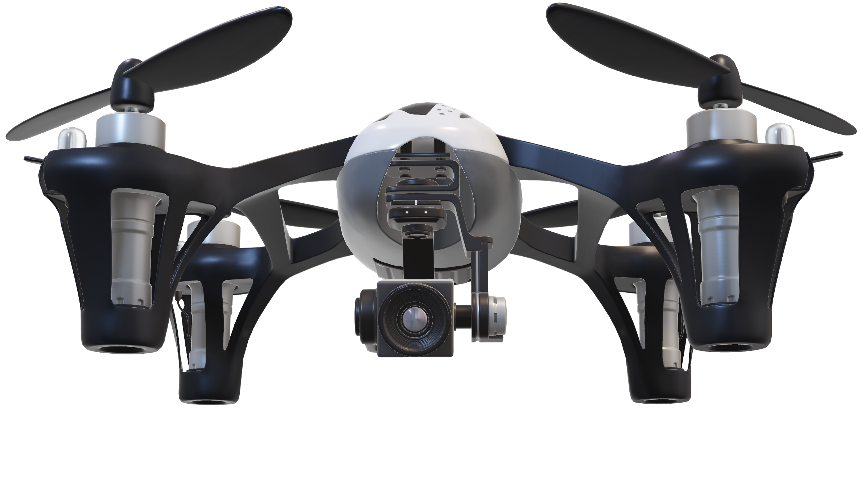
Requirements
Data Transmission Requirements
Data processed on the drone transmitted to ground station
Ground station receives and display data to the operator
Transmission via WiFi (2.4GHz or 5.2GHz)
Machine Learning Requirements
Machine learning model fits on FPGA
Model detects pedestrians and outputs bounding boxes

Slide 12
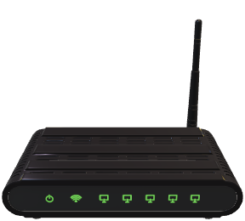

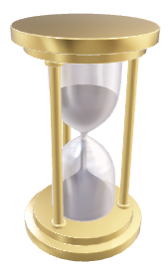

Constraints
Time & Budget
Future-Proofing
Power & Weight
Data Transmission
Limited to C$1,000
Limited time to perform 2 sub-projects
Coordination and leadership is challenging
FPGA chip area big enough for future ML models
Battery power is limited
Weight and power draw affects flight duration
Portability
Limited bandwidth for data
Limited power emission
Limited range

Slide 13
Viable?

Slide 14
Viability
Assess system feasibility on 3 objectives:
1
2
3
Integration of FPGA with a Drone
Air-to-Ground Data Transmission
ML Implementation on FPGA

Slide 15
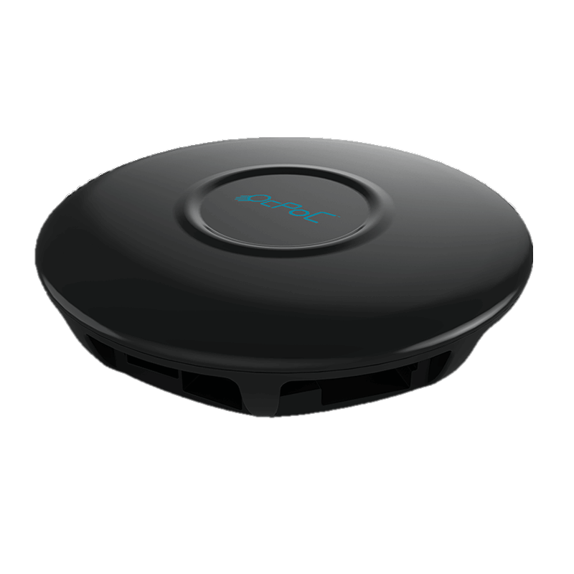
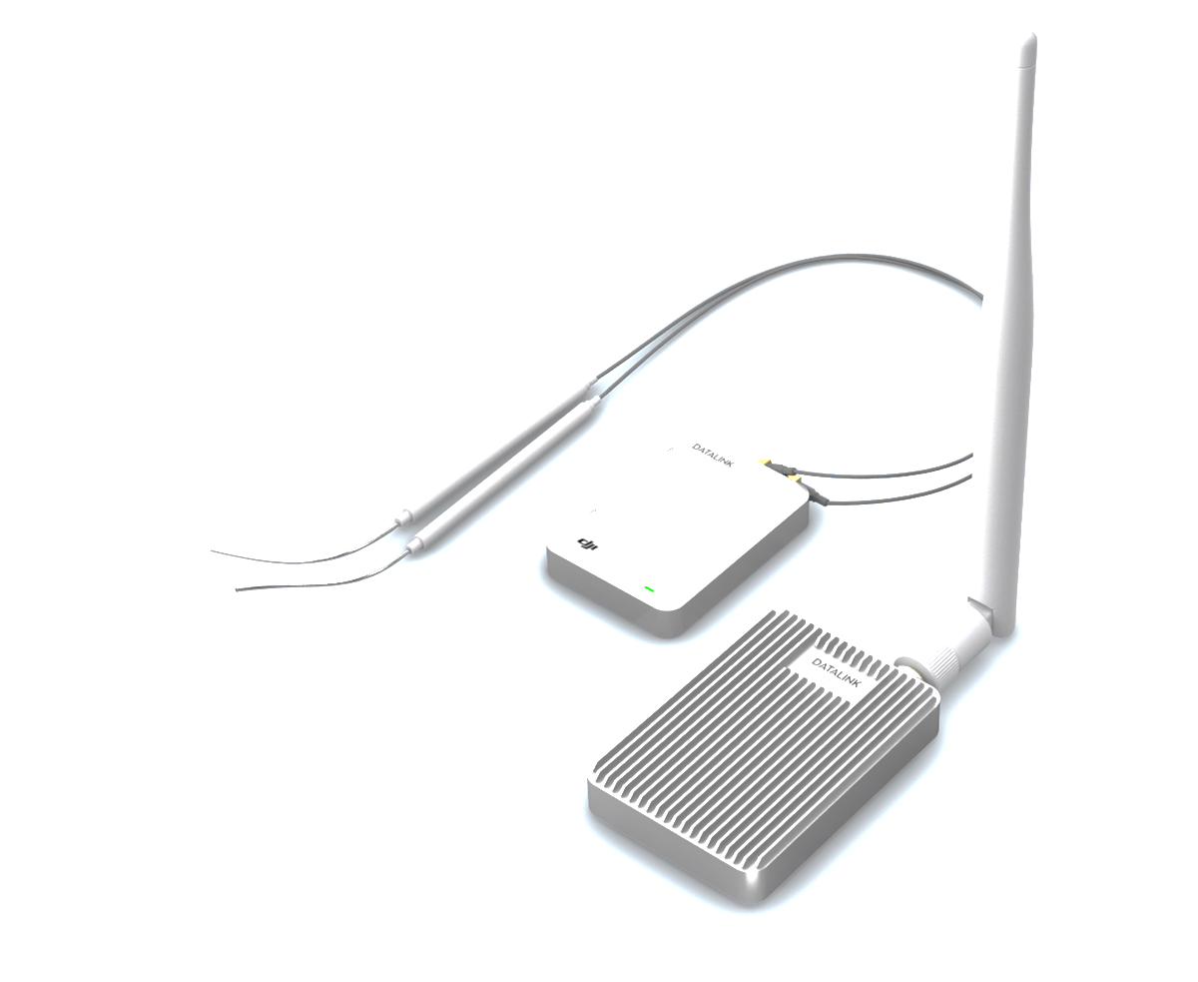

Viability
All three objectives individually has existing solutions
1
2
3
Integration of FPGA with a Drone
Air-to-Ground Data Transmission
ML Implementation on FPGA
Aerotenna FPGA flight controller
SymbioticEDA MARLANN
DJI DATALINK

Slide 16
Viability
Combination of the three will further this field of research
This project is a proof-of-concept

Slide 17
Risks?
Notes:
What are the risks
We are carefully considering all risks of the project. The top risks is in 4 categories: management risks, hardware risks, software risks, and legacy risks.

Slide 18




Risks
Hardware
Management
Legacy
Software
Flight crashes
Loss of FPGA
Loss of drone
Insufficient commitment
Poor task management
Poor decision making
Low repairability / maintainability
Client doesn’t know how to operate
Tech. debt
Inadequate documentation
Notes:
Hardware - highest priority because the hardware is very fragile. A single crash of the drone could result in total loss --- with little chance of receiving extra budget.
Management- include non-technical risks such as ….
Legacy Risks - Because the project is to be used for the long term by the client for research and development. We need to ensure the deliverable has acceptable longevity.
What if certain part on the drone require maintenance or replacement?
What if the radio or the transmitter doesn't work
What if X doesn't work? What if Y breaks?
Software Risks – lowest risk in terms of severity because – not client’s top priority, software workarounds, fixes has faster turnaround & cheaper

Slide 19
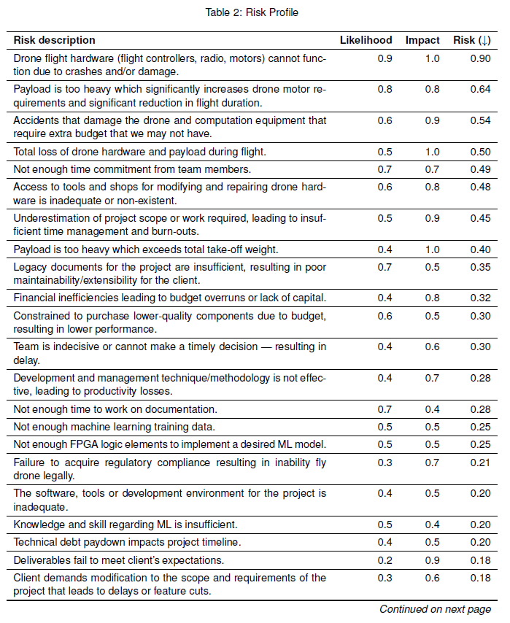
Risk Management
We keep track of an updated copy of the risk profile
Active mitigation on risks with index ≥ 0.4
Triage tasks to mitigate risk
Weekly update on risk status
Passively monitoring on risks with index < 0.4
Notes:
How we manage risks
We use a risk profile table.
Each week the matrix is updated: new potential risks is added to the matrix along with their likelihood and impact. We carefully consider these metrics as it will affect how much effort we are putting in into strategies to mitigate the risks with high severity.
If the risk index is greater than 0.4, we will actively follow the risk mitigation protocol: which involves triaging tasks related to mitigate the risk on Trello.
Risk index less than 0.4 are monitored, but not actively mitigated due to time constraints.

Slide 20

Risk Management
Hardware
Management
Legacy
Software
Follow safety protocol
Only power on when absolute ready
Weekly updates and status report on assigned tasks
Timeline closely tracked
Actively updating all documents alongside changes
Version tracking
Code review
Notes:
Hardware
Safety protocol such as only attaching the propellers to the drone as the last task when the drone absolutely ready for take off Management
Clear and effective communication and management strategies such as weekly standups, WSRs. We use scrum board to ensure we’re on-track on timeline
Legacy
actively updating the specification documents, operation manual, etc.
We will not leave these document as a last-minute consideration. These documents are to be updated in parallel as we continue with our development.
Software
Use version tracking and employ code review – pull request must be reviewed before merging.

Slide 21
Solution?

Slide 22
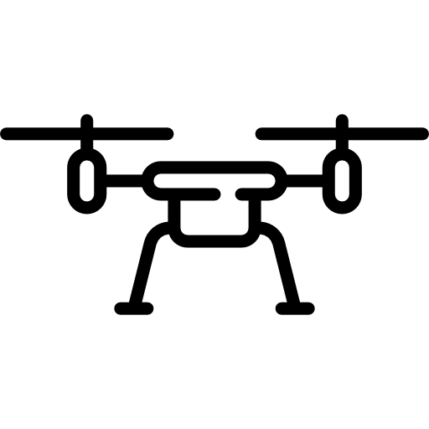





Deliverables
FPGA 🖤 ML
1x
1x
1x
5x

Slide 23
Deliverable Dates
Feb 10
Second Prototype
Drone, control, data transmission
Power systems
Intermediate ML
2019
2020
Nov 25
First Prototype
April 3
Final Product Delivery
Initial ML demo
Video capture from drone

Slide 24



Immediate Steps
Start Small
Start Quickly
Start Legally
Function over scale
Integrate existing model
Create purchasing plans
Tool setup takes time
Drone registration
Pilot and radio certifications

Slide 25
Q?

Slide 26
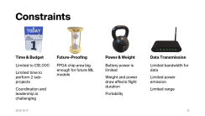
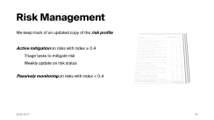
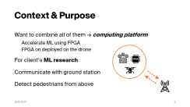
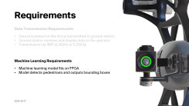
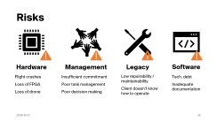
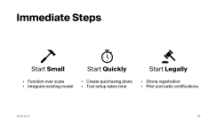
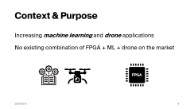
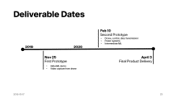
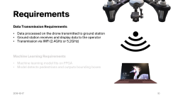
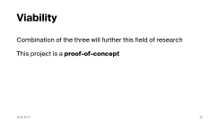
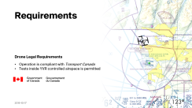
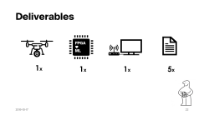
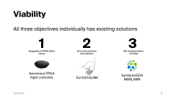
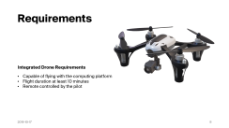
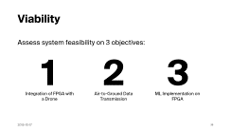
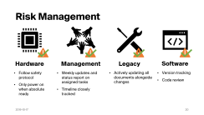
Q?

Slide 27
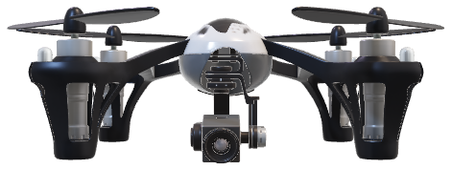
Milestone I Presentation
FPGA for Machine Learning on a Drone

